Slide 1
Walmart Sales Analysis
By Pasumarthi Sri Sreshta

Slide 2
Contents
1) Dataset overview
2) Insights

Slide 3
Dataset Overview
The dataset consists of the following columns:
• Invoice_ID: Unique identifier for each invoice.
• Branch: Branch of the store where the sale took place.
• City: City where the store branch is located.
• Customer_type: Type of customer (e.g., Member, Normal).
• Gender: Gender of the customer.
• Product_line: Category of the product sold.
• Unit_price: Price per unit of the product.
• Quantity: Quantity of the product sold.
• Tax_5%: Tax applied on the sale.
• Total: Total amount of the sale.
• Date: Date of the transaction.
• Time: Time of the transaction.
• Payment: Payment method used (e.g., Cash, Credit Card).
• cogs: Cost of goods sold.
• gross_margin_percentage: Gross margin percentage.
• gross_income: Gross income from the sale.
• Rating: Customer rating for the purchase.

Slide 4
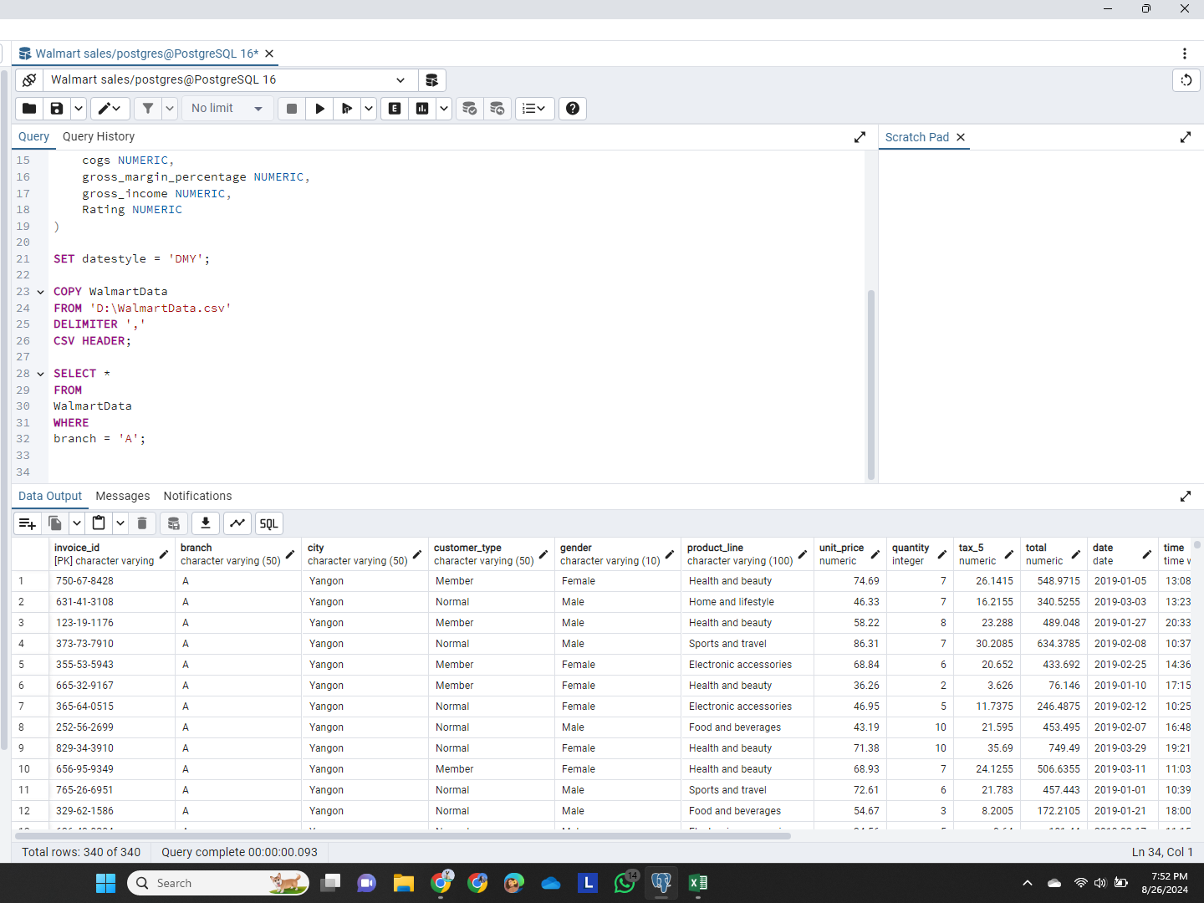
SQL Query 1: Sales by Specific Branch
Query: Retrieve all columns for sales made in Branch 'A'.

Slide 5
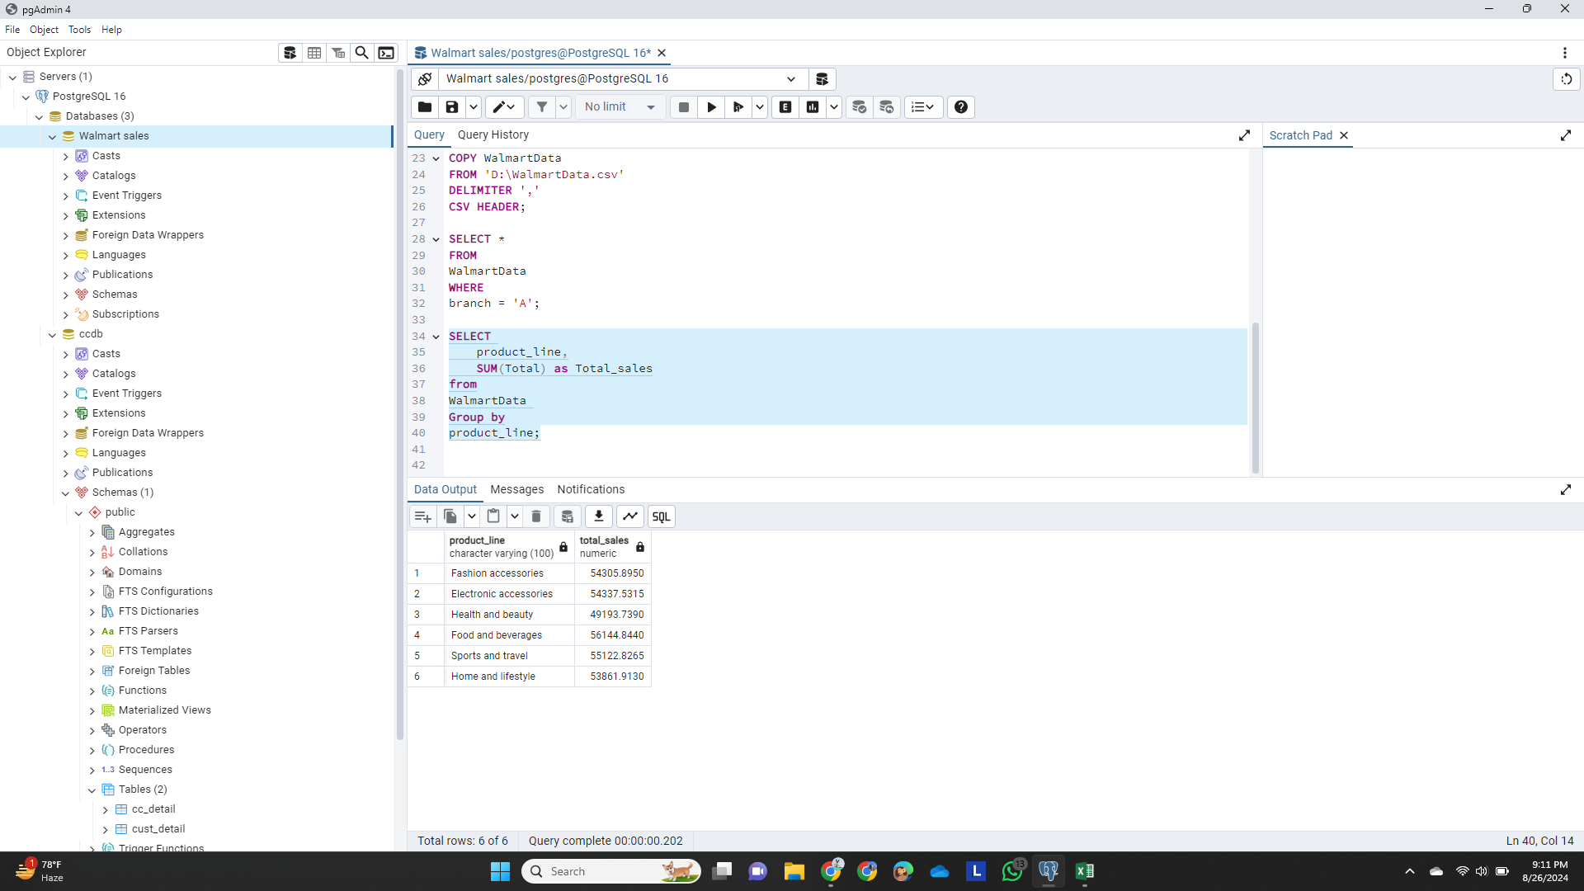
SQL Query 2: Total Sales per Product Line
Query: Find the total sales for each product line.

Slide 6
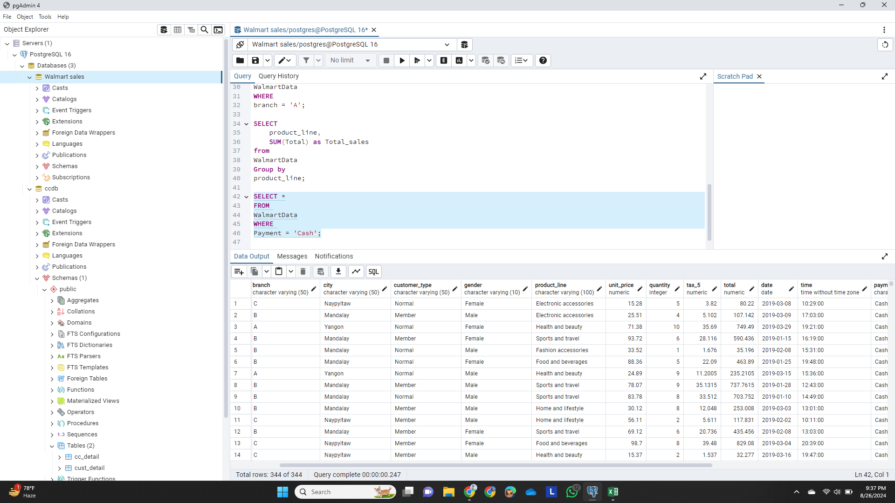
SQL Query 3: Cash Payment Transactions
Query: List all sales transactions where the payment method was 'Cash'.

Slide 7
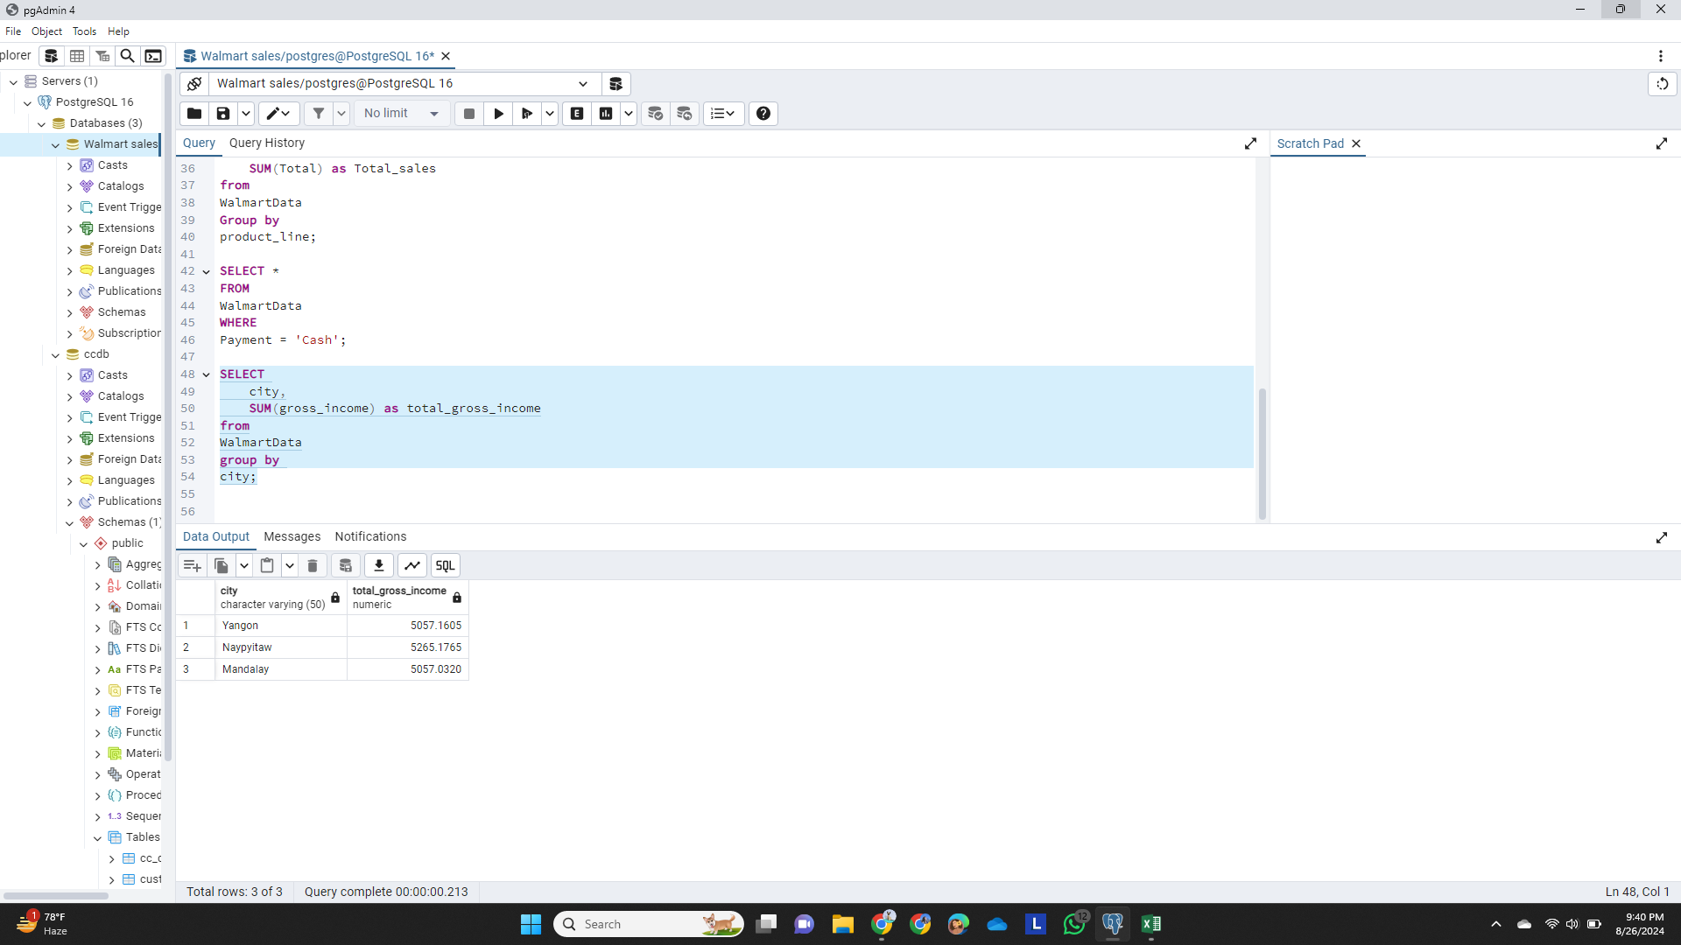
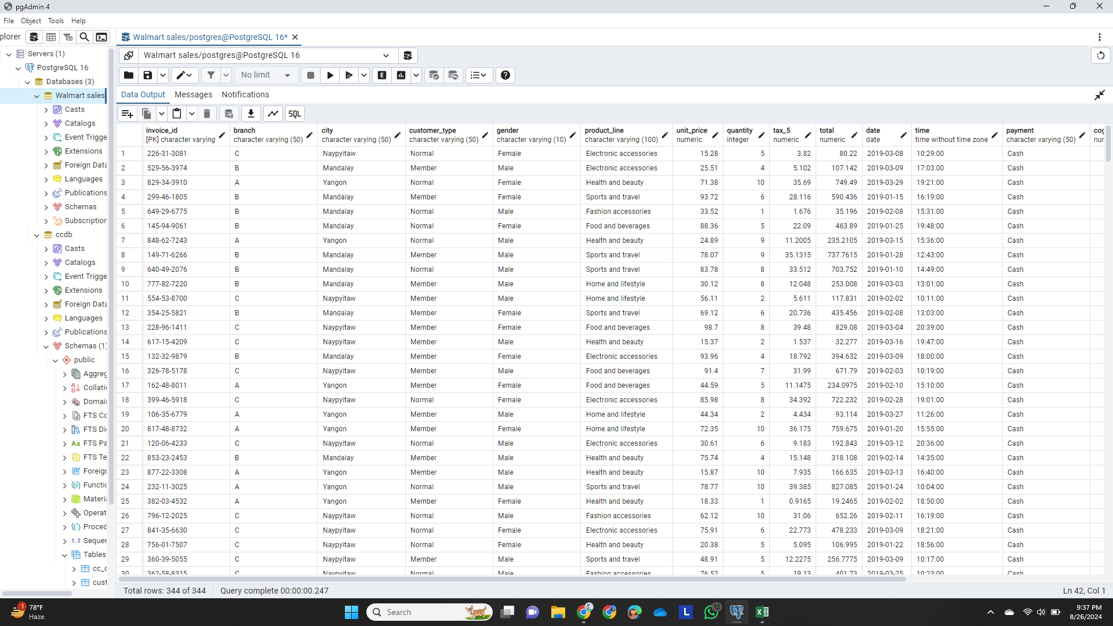
SQL Query 4: Gross Income by City
Query: Calculate the total gross income generated in each city.

Slide 8
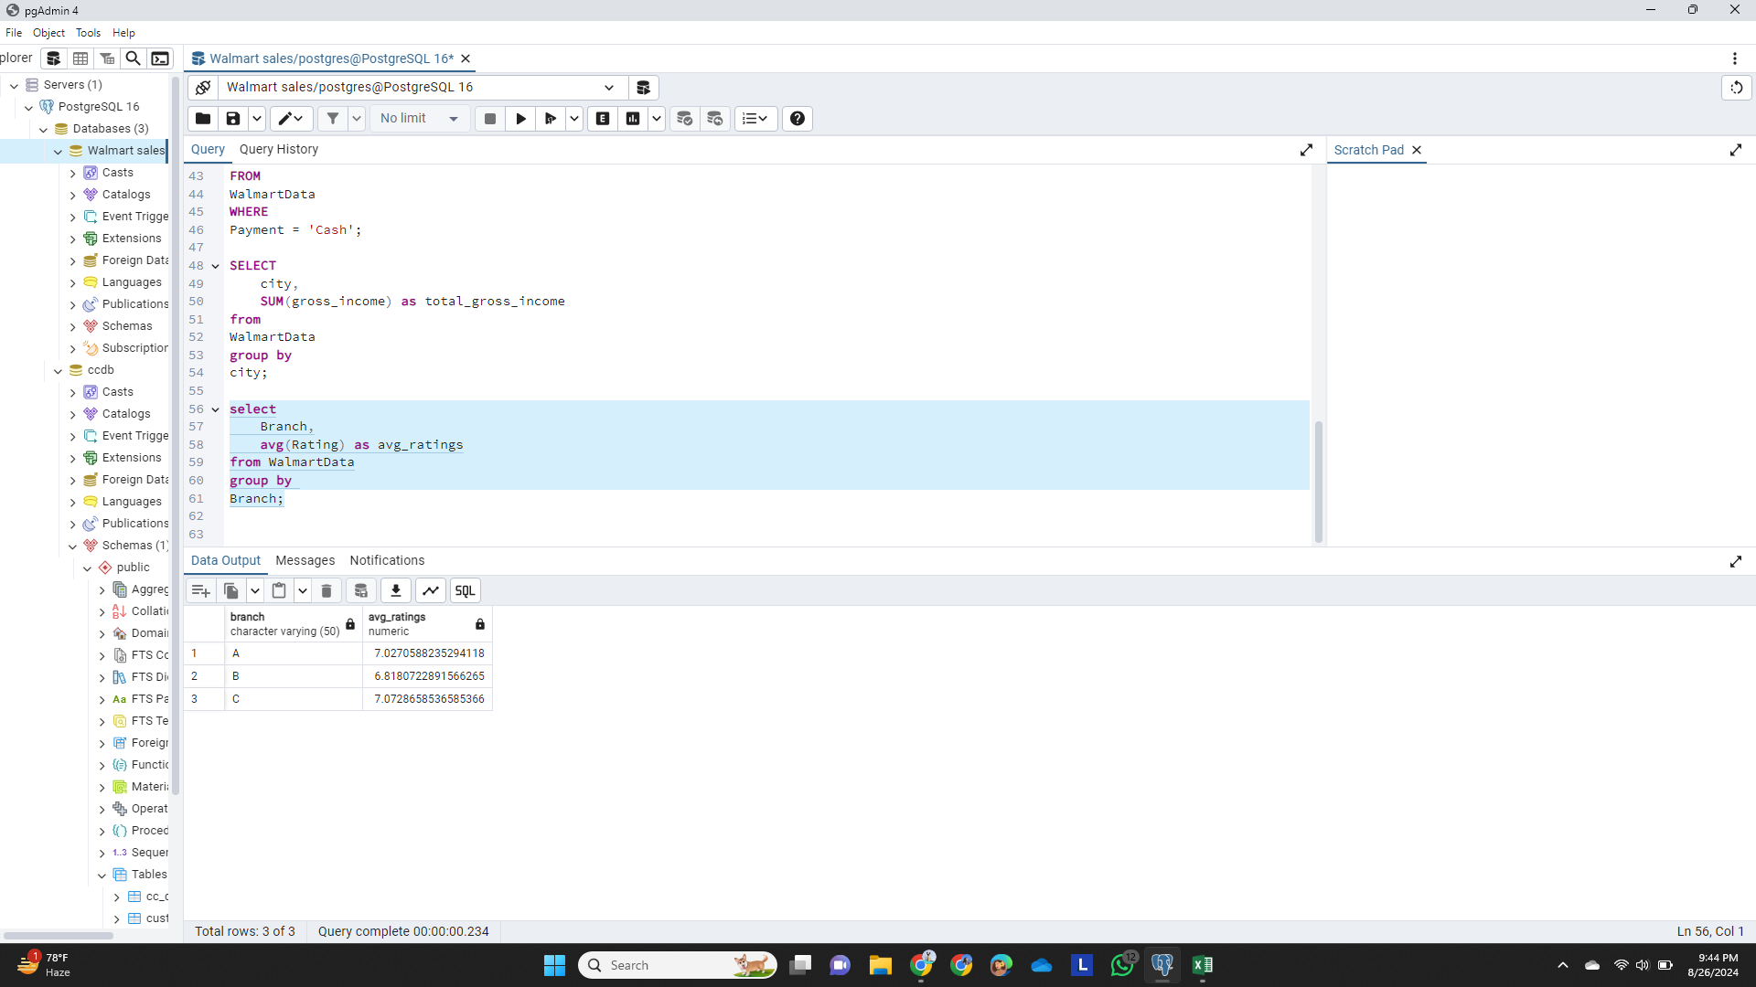
SQL Query 5: Average Customer Rating per Branch
Query: Find the average rating given by customers in each branch.

Slide 9
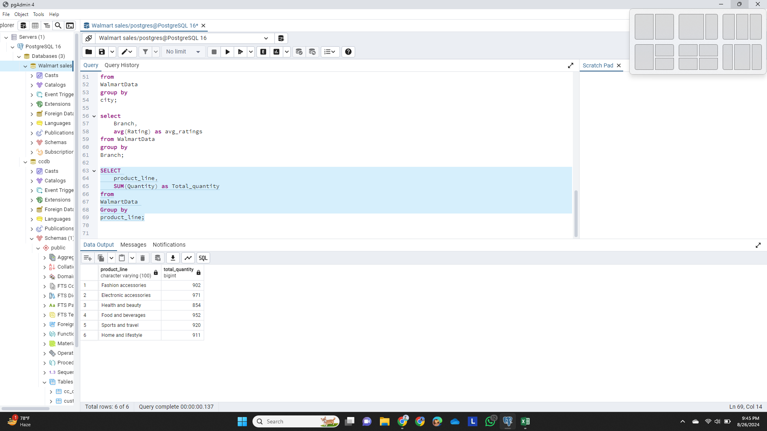
SQL Query 6: Total Quantity Sold per Product Line
Query: Determine the total quantity of each product line sold.

Slide 10
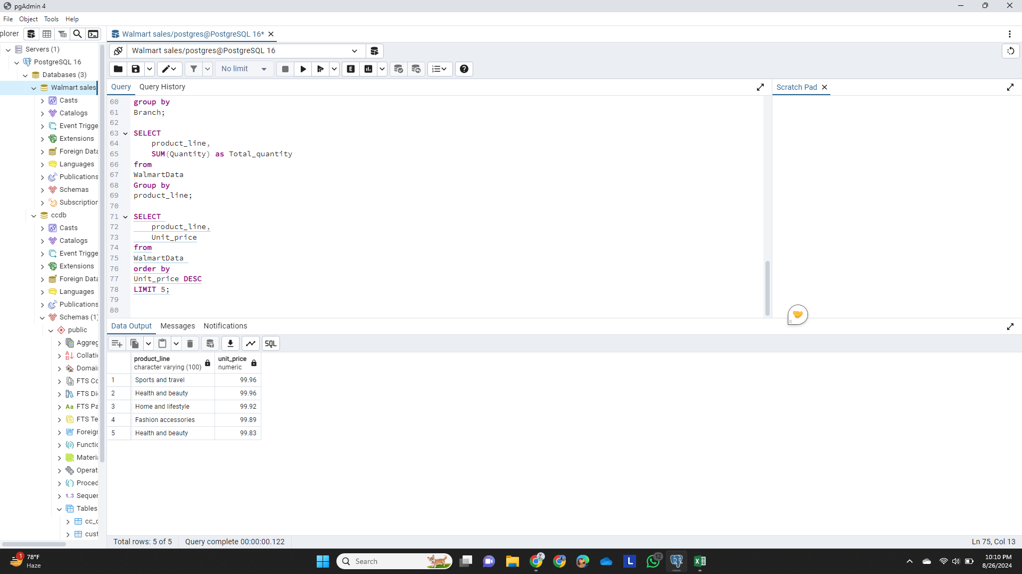
SQL Query 7: Top 5 Products by Unit Price
Query: List the top 5 products by unit price.

Slide 11
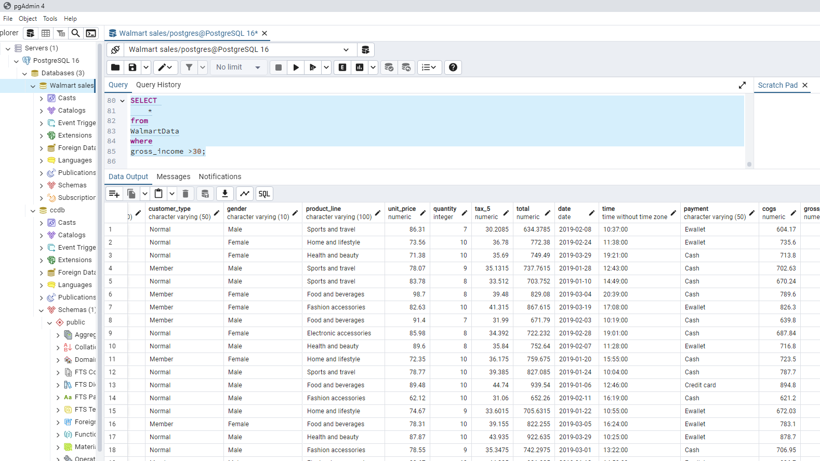
SQL Query 8: High Gross Income Transactions
Query: Find sales transactions with a gross income greater than 30.

Slide 12
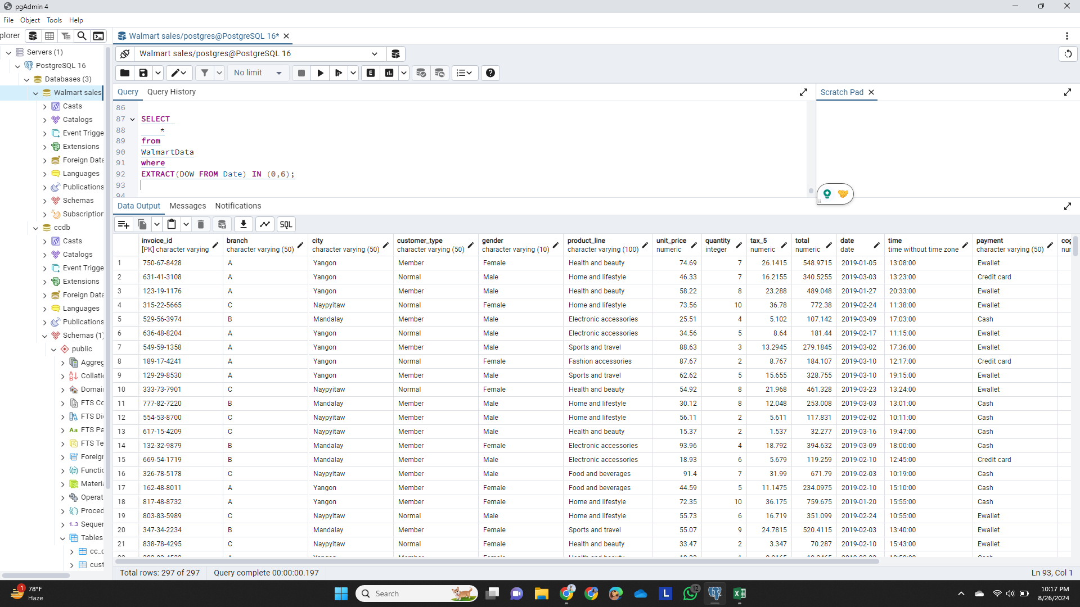
SQL Query 9: Weekend Sales Transactions
Query: Retrieve sales transactions that occurred on weekends.

Slide 13
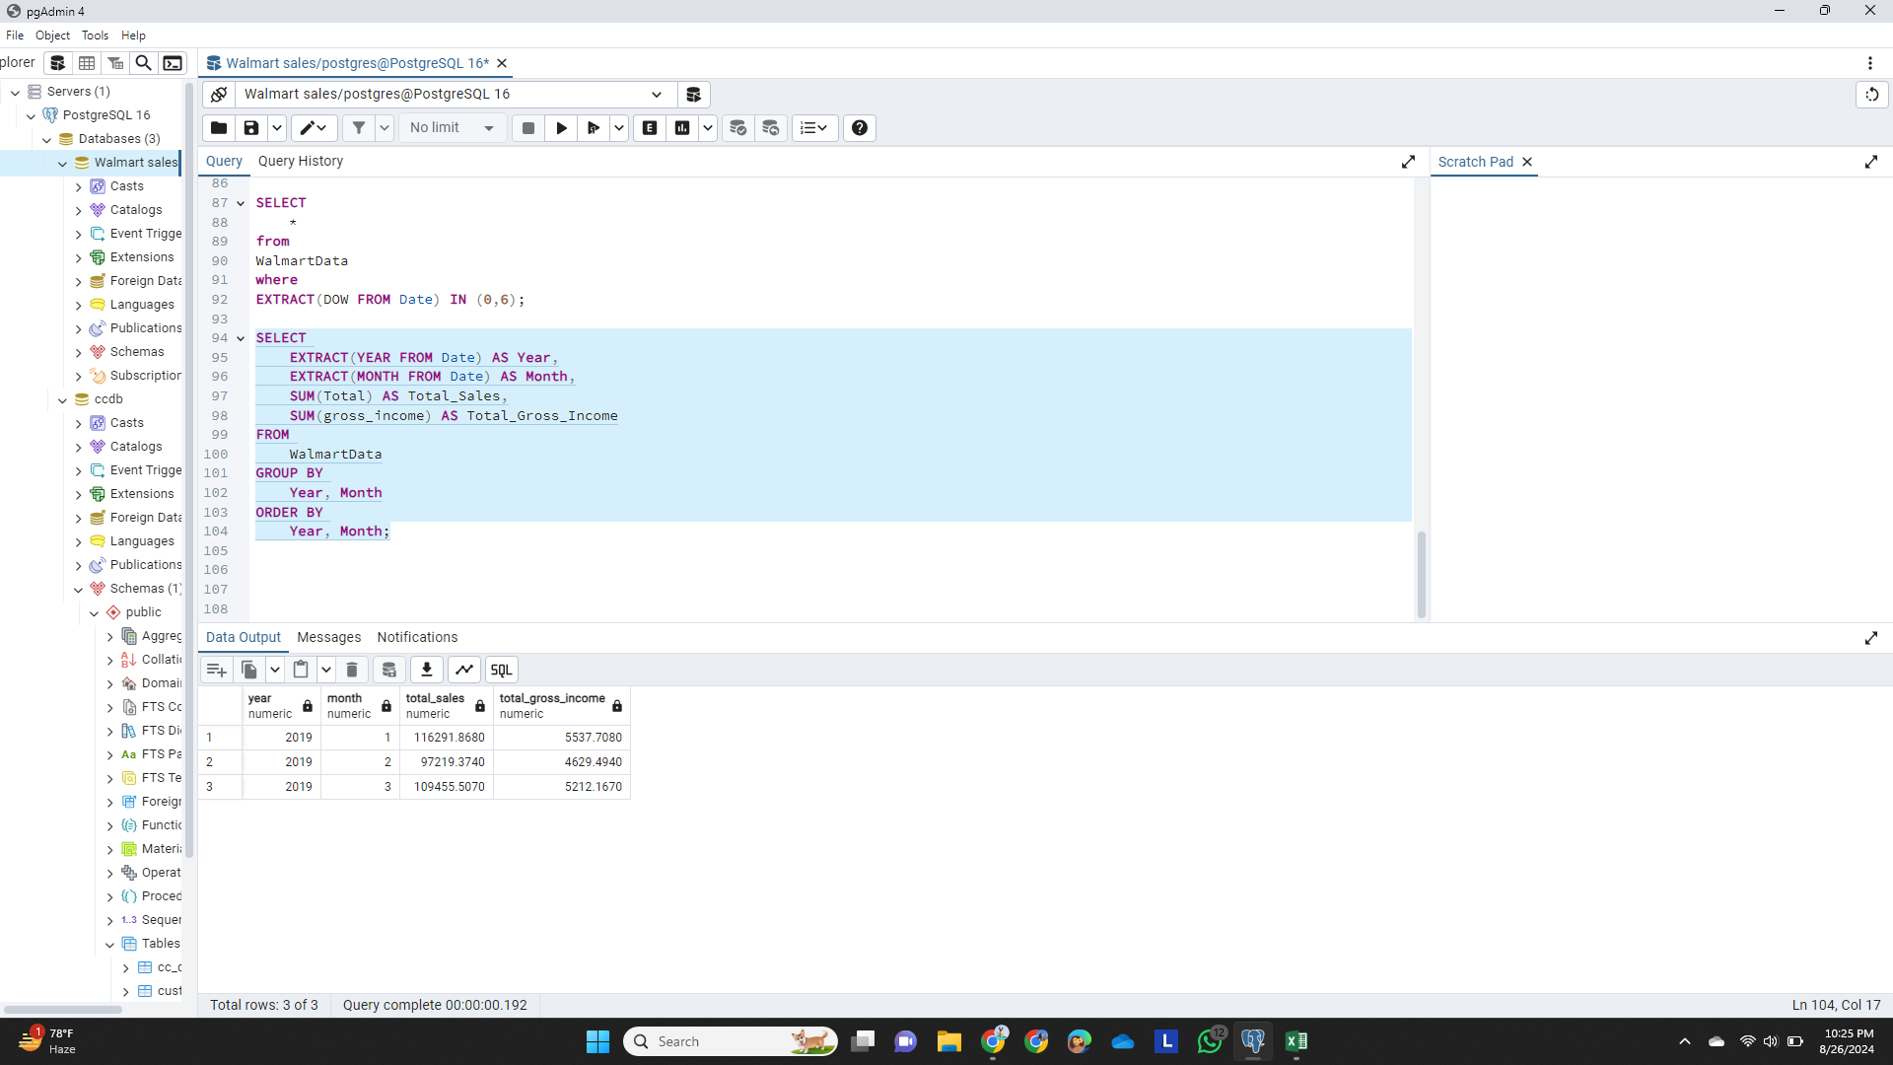
SQL Query 10: Monthly Sales and Gross Income
Query: Calculate the total sales and gross income for each month.

Slide 14
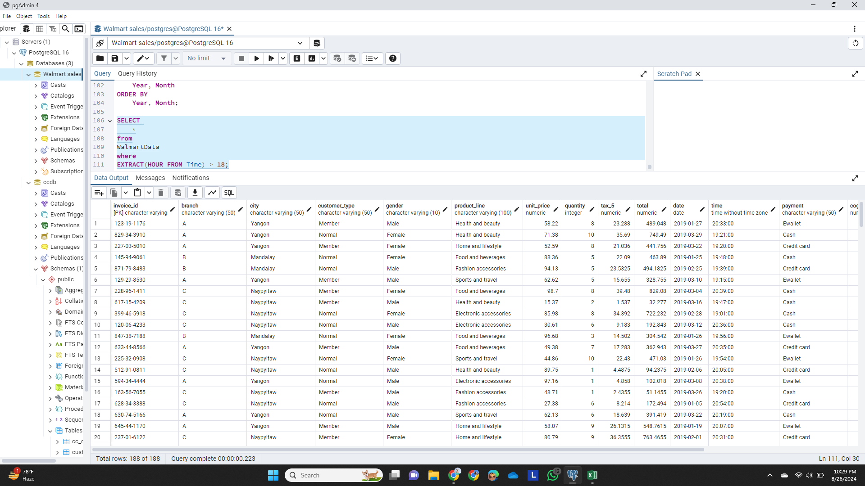
SQL Query 11: Sales After 6 PM
Query: Find the number of sales transactions that occurred after 6 PM.

Slide 15
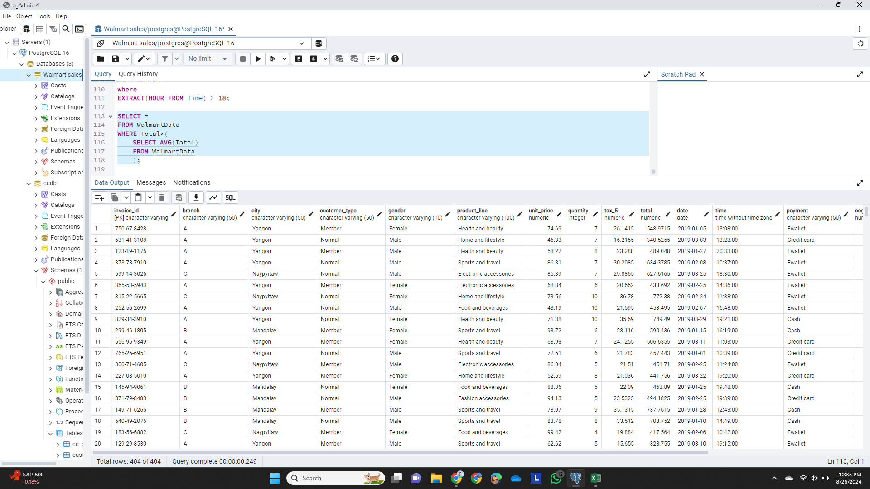
SQL Query 12: Sales Above Average Total
Query: List the sales transactions that have a higher total than the average total of all transactions.

Slide 16
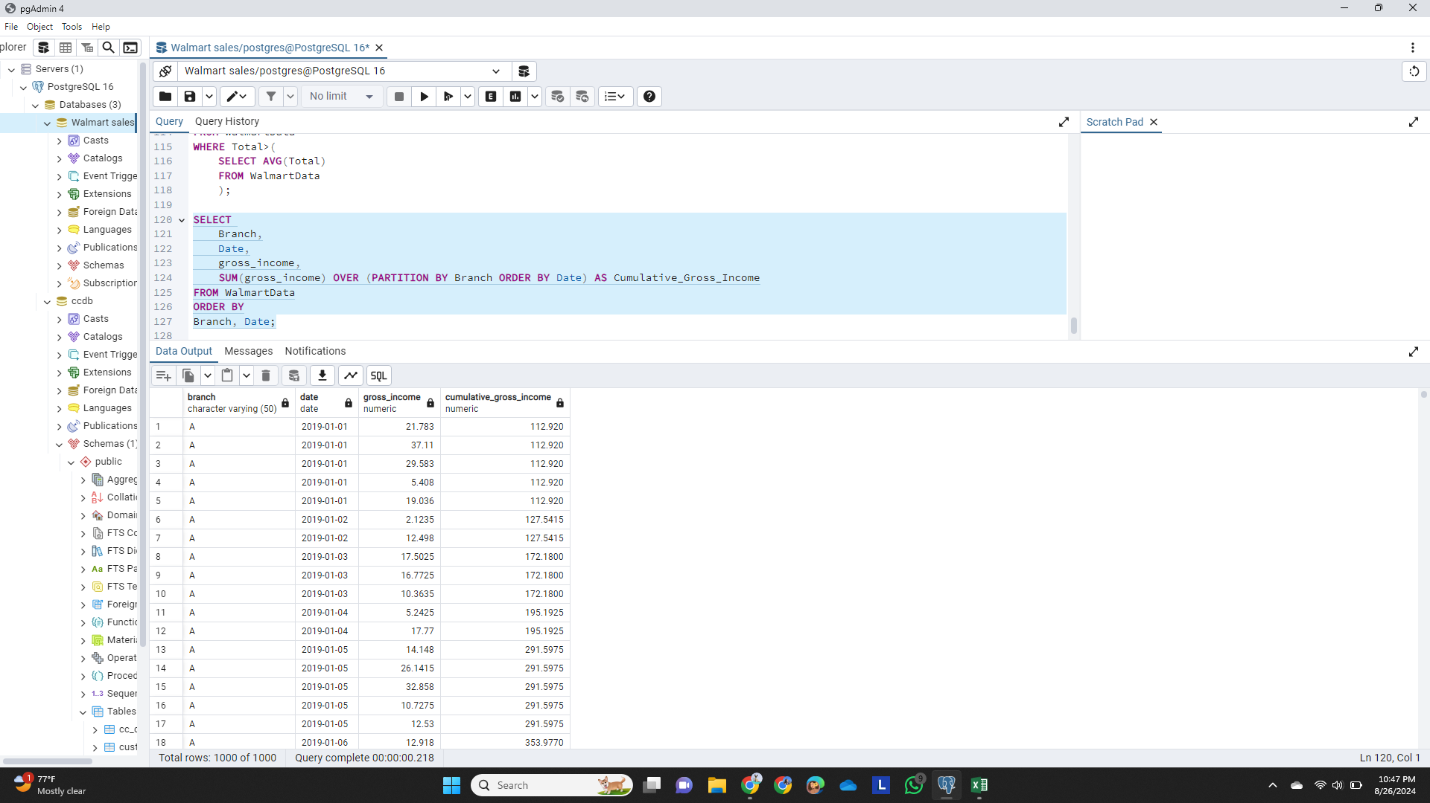
Query 13: Cumulative Gross Income by Branch
Query: Calculate the cumulative gross income for each branch by date.

Slide 17
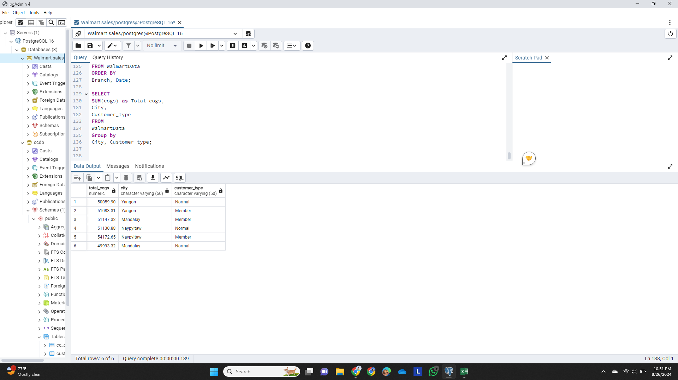
SQL Query 14: Total COGS by Customer Type and City
Query: Find the total cost of goods sold (COGS) for each customer type in each city.

